Slide 1
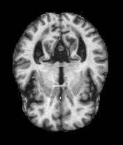
Alzheimer's Disease Detection using Deep Learning
Team : F
Vikas (TD68615)
Chandana (QZ89614)
Sailesh V (CZ93536)

Slide 2
Topic Outline
Introduction Medical Thesis
Deep Learning Usage in Alzheimer's Detection
Contrasting Medical Procedures and Deep Learning Techniques Dataset and Models Identified and used
Exploratory Data Analysis
Presentation Outline

Slide 3
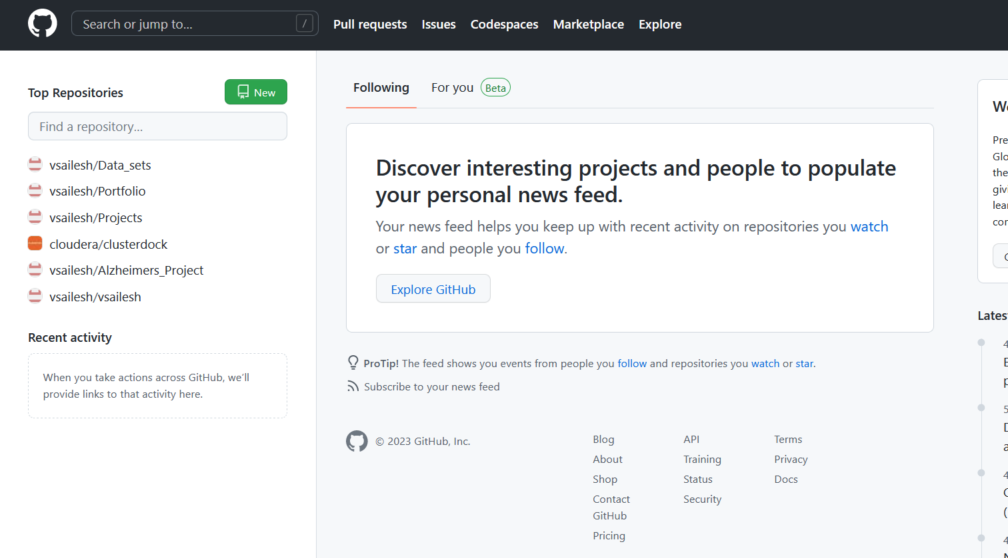
GIT HUB
https://github.com/vsailesh/Alzheimers_Project

Slide 4
Introduction
A L Z H E I M E R ' S D I S E A S E
Alzheimer’s disease is an irreversible, progressive brain disorder that slowly
destroys memory and thinking skills and, eventually, the ability to carry out the
simplest tasks.
S Y M P T O M S
Requires a medical diagnosis
Memory loss and confusion are the main symptoms.
People may experience:
Cognitive Behavioral.
Mood
Psychological
inability to combine muscle
movements, jumbled speech, or loss of appetite

Slide 5
Dataset
Alzheimer's Dataset ( 4 class of Images) Images of MRI Segmentation
Images : 5121 Images Train – Test Split: 4098 - 1023
Alzheimer's Dataset Oasis Logitudinal(Numerical)
C L A S S E S :
D E M E N T E D
N O N D E M E N T E D
C O N V E R T E D
C L A S S E S :
M I L D D E M E N T E D
V E R Y M I L D D E M E N T E D
N O N D E M E N T E D
M O D E R A T E D E M E N E T E D

Slide 6

Medical Thesis
It is the cause of 60–70% of cases of dementia. Experts haven’t determined a single cause of Alzheimer’s disease but they have identified certain risk factors, including:
Age. Most people who develop Alzheimer’s disease are 65 years of age or older.
Family history. If you have an immediate family member who has developed the condition, you’re more likely to get it.
Genetics. Certain genes have been linked to Alzheimer’s disease.

Slide 7
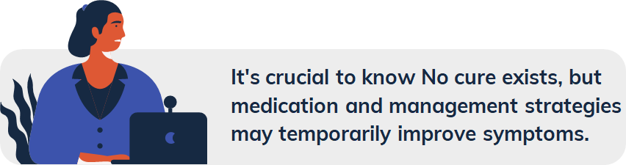
Alzheimer’s Stages :
Stage 1. There are no symptoms at this stage but there might be an early diagnosis based on family history.
Stage 2. The earliest symptoms appear, such as forgetfulness.
Stage 3. Mild physical and mental impairments appear, such as reduced memory and concentration. These may only be noticeable by someone very close to the
person.
Stage 4. Alzheimer’s is often diagnosed at this stage, but it’s still considered mild. Memory loss and the inability to perform everyday tasks is evident.
Stage 5. Moderate to severe symptoms require help from loved ones or caregivers. Stage 6. At this stage, a person with Alzheimer’s may need help with basic tasks,
such as eating and putting on clothes.
Stage 7. This is the most severe and final stage of Alzheimer’s. There may be a loss of speech and facial expressions.
Stage 1. There are no symptoms at this stage but there might be an early diagnosis based on family history.
Stage 2. The earliest symptoms appear, such as forgetfulness.
Stage 3. Mild physical and mental impairments appear, such as reduced memory and concentration. These may only be noticeable by someone very close to the
person.
Stage 4. Alzheimer’s is often diagnosed at this stage, but it’s still considered mild. Memory loss and the inability to perform everyday tasks is evident.
Stage 5. Moderate to severe symptoms require help from loved ones or caregivers. Stage 6. At this stage, a person with Alzheimer’s may need help with basic tasks,
such as eating and putting on clothes.
Stage 7. This is the most severe and final stage of Alzheimer’s. There may be a loss of speech and facial expressions.

Slide 8
H O W D E E P L E A R N I N G H E L P S ?
The end to- end process of neural networks has been employed for pattern classification allows us to make more clear and proper classification of the disease.
DEEP LEARNING USAGE IN ALZHEIMER’S DETECTION
M A C H I N E L E A R N I N G V S D E E P
L E A R N I N G
Deep Learning techniques have shown more accurate and precised results than Machine learning models by incorporating the ANN(Artificial Neural Network) and CNN(Convolutional Neural Networks) models than
traditional models.
B A S I C U S E O F I M A G E S A S D A T A
When we focus on early diagnosis of AD based on convolutional neural networks (ConvNets) by using magnetic resonance imaging (MRI). Image slices of gray matter and white matter from MRI have been used as the inputs for classification.

Slide 9
Diagnosis
Techniques
Medical Procedures
Deep Learning Techniques
•MRI (Magnetic Resonance Imaging)
•CT-SCAN
•PET ,EEG
• ANN(Artificial Neural Networks)
• CNN(Convolutional Neural Networks)
• SVM(Support Vector Machine)
•Logistic Regression And many more..

Slide 10
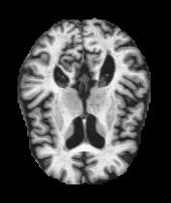
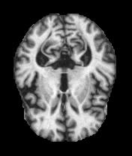
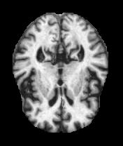
Dataset
Moderate Demented
No Demented
Very Mild Demented
Mild Demented

Slide 11
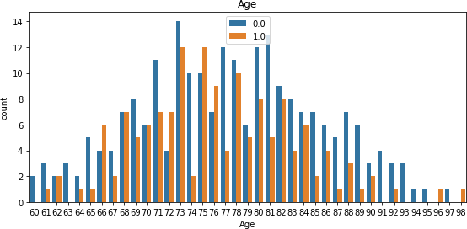
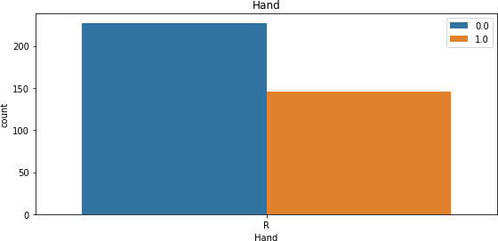
EDA
Age Factor
Hand Usage

Slide 12
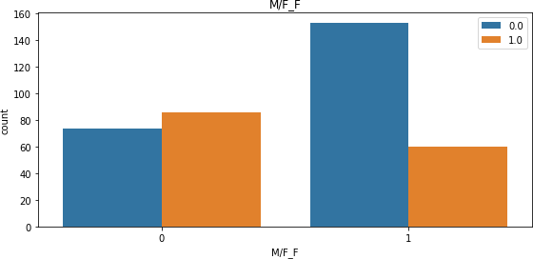
Male vs Female Disease
Contraction
0- Demented Blue- Male
1- Non Demented Orange- Female

Slide 13
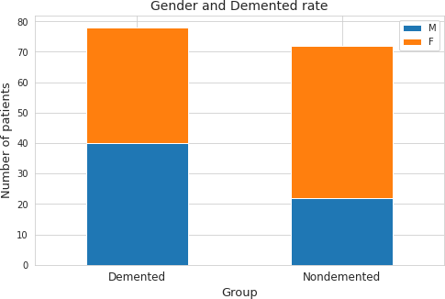
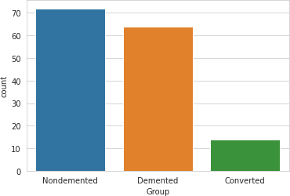
Disease Types Detected
Male/Female with Demented

Slide 14
Reference:
Dubey, S. (2019, December 26). Alzheimer's dataset ( 4 class of images). Kaggle. Retrieved February 28, 2023, from https://www.kaggle.com/datasets/tourist55/alzheimers-dataset-4-class-of-images?resource=download
Centers for Disease Control and Prevention. (2020, October 26). What is alzheimer's disease? Centers for Disease Control and Prevention. Retrieved February 28, 2023, from https://www.cdc.gov/aging/aginginfo/alzheimers.htm

